Slide 1
Course Introduction

Slide 2

Deep learning
RNN / LSTM
CNN
ANN
RBM

Slide 3
To tell the truth

Slide 4
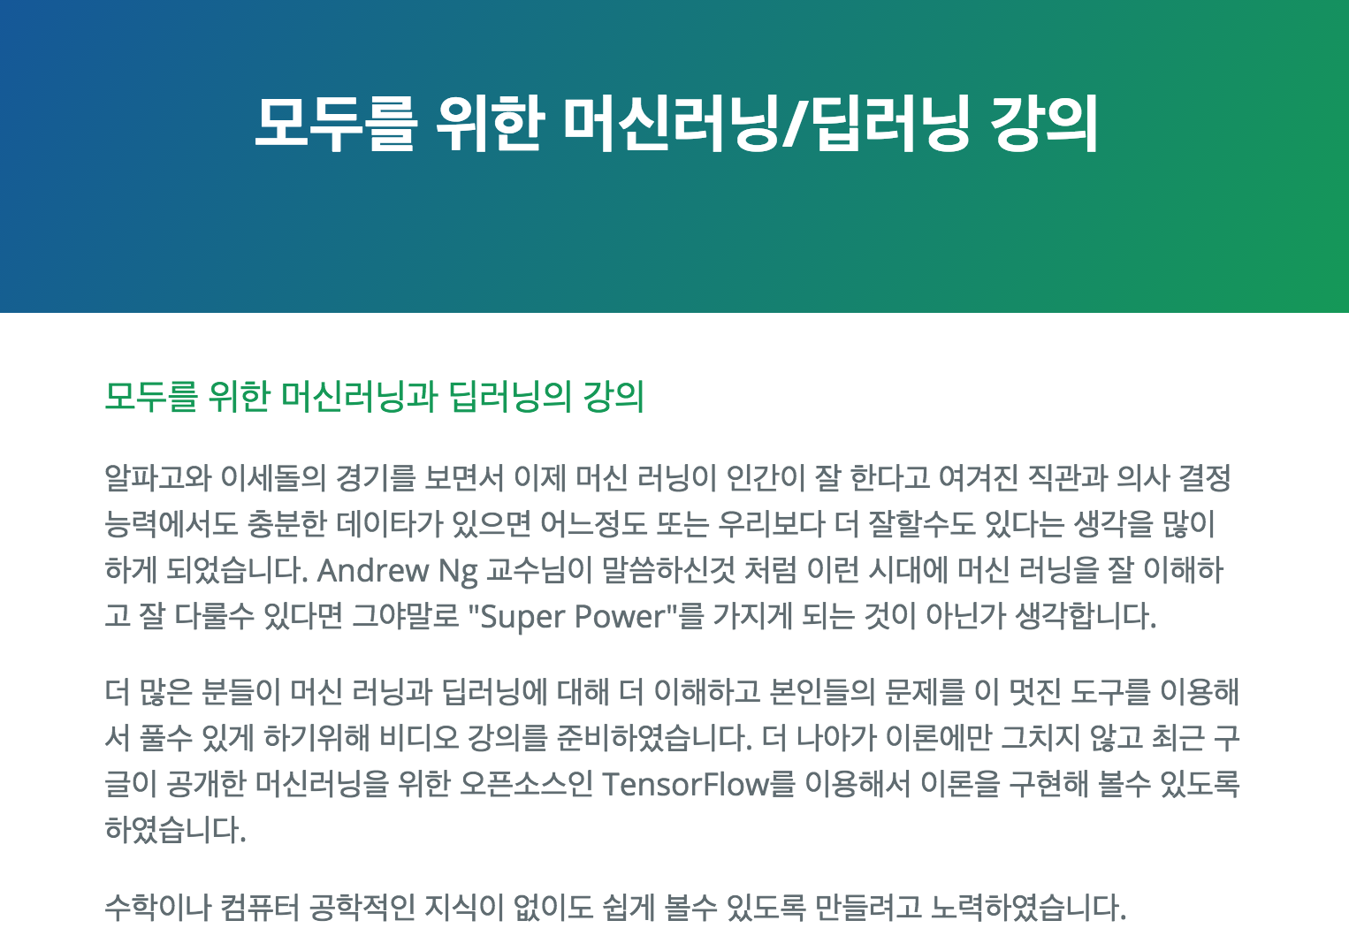
Deep learning tutorials?
http://hunkim.github.io/ml/

Slide 5
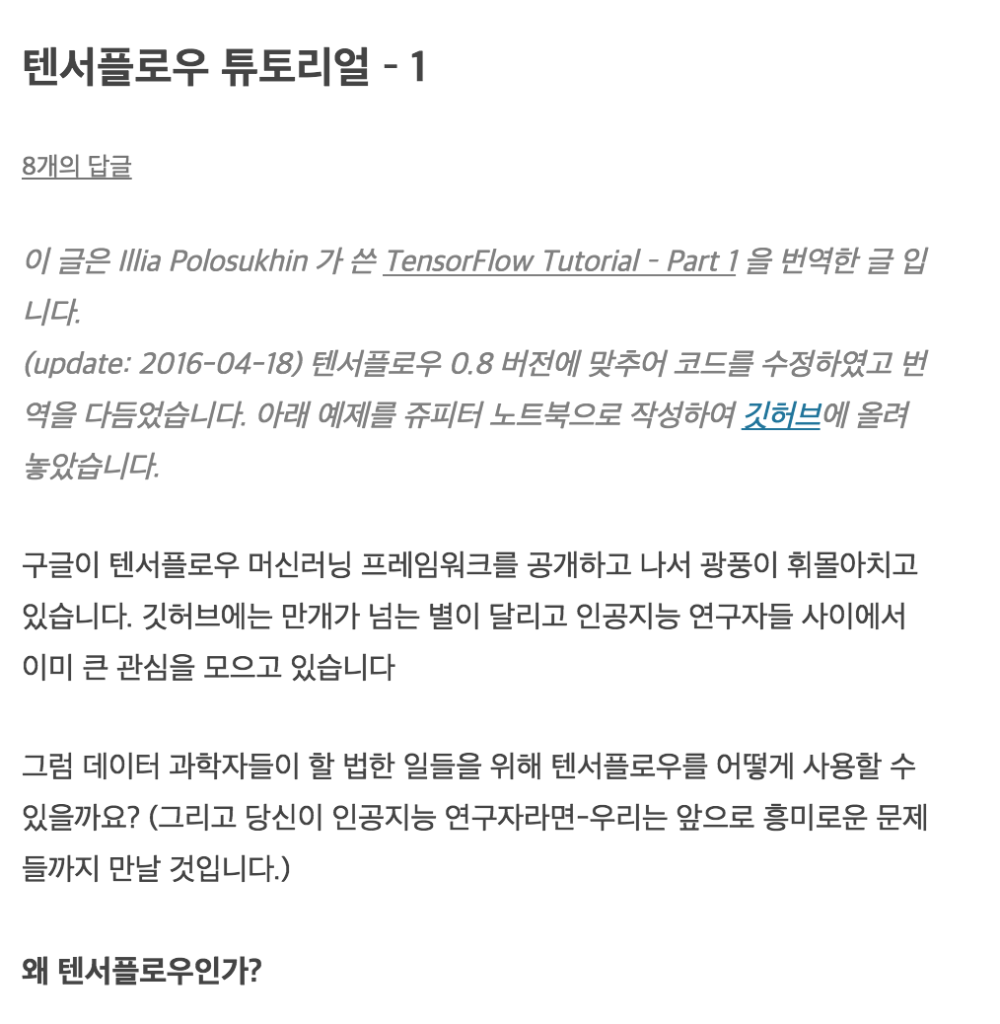
Deep learning tutorials?
https://tensorflowkorea.wordpress.com/2015/12/04/%ED%85%90%EC%84%9C%ED%94%8C%EB%A1%9C%EC%9A%B0-%ED%8A%9C%ED%86%A0%EB%A6%AC%EC%96%BC-1/

Slide 6
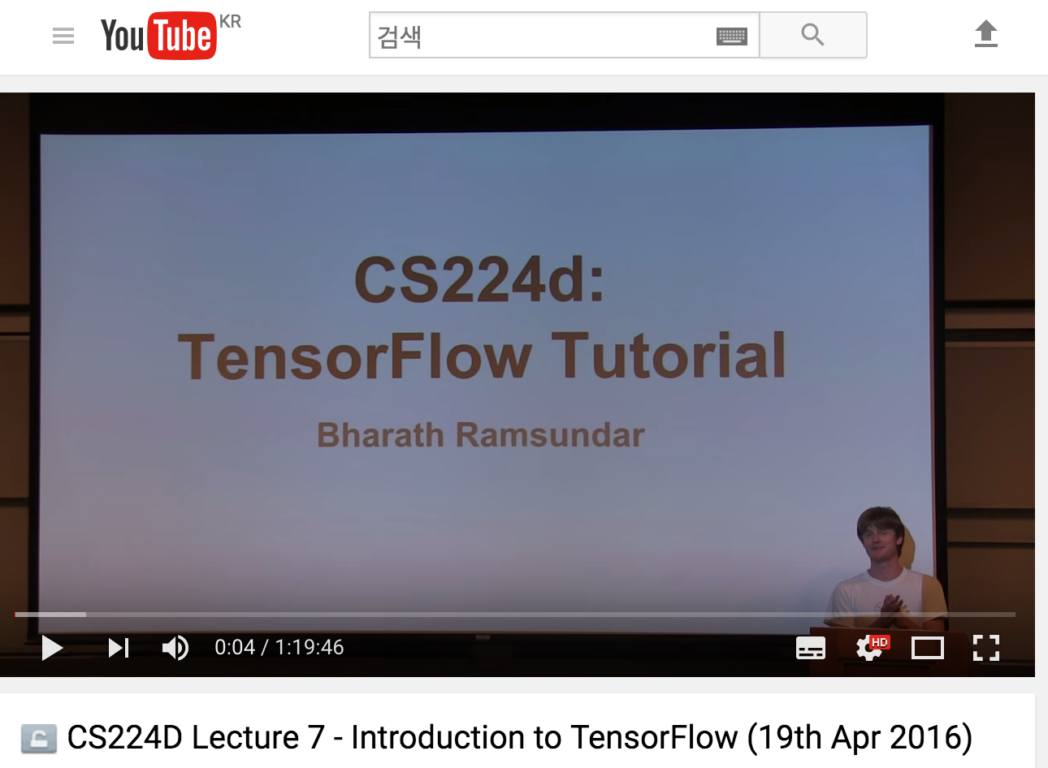
Deep learning tutorials?
https://www.youtube.com/watch?v=L8Y2_Cq2X5s

Slide 7
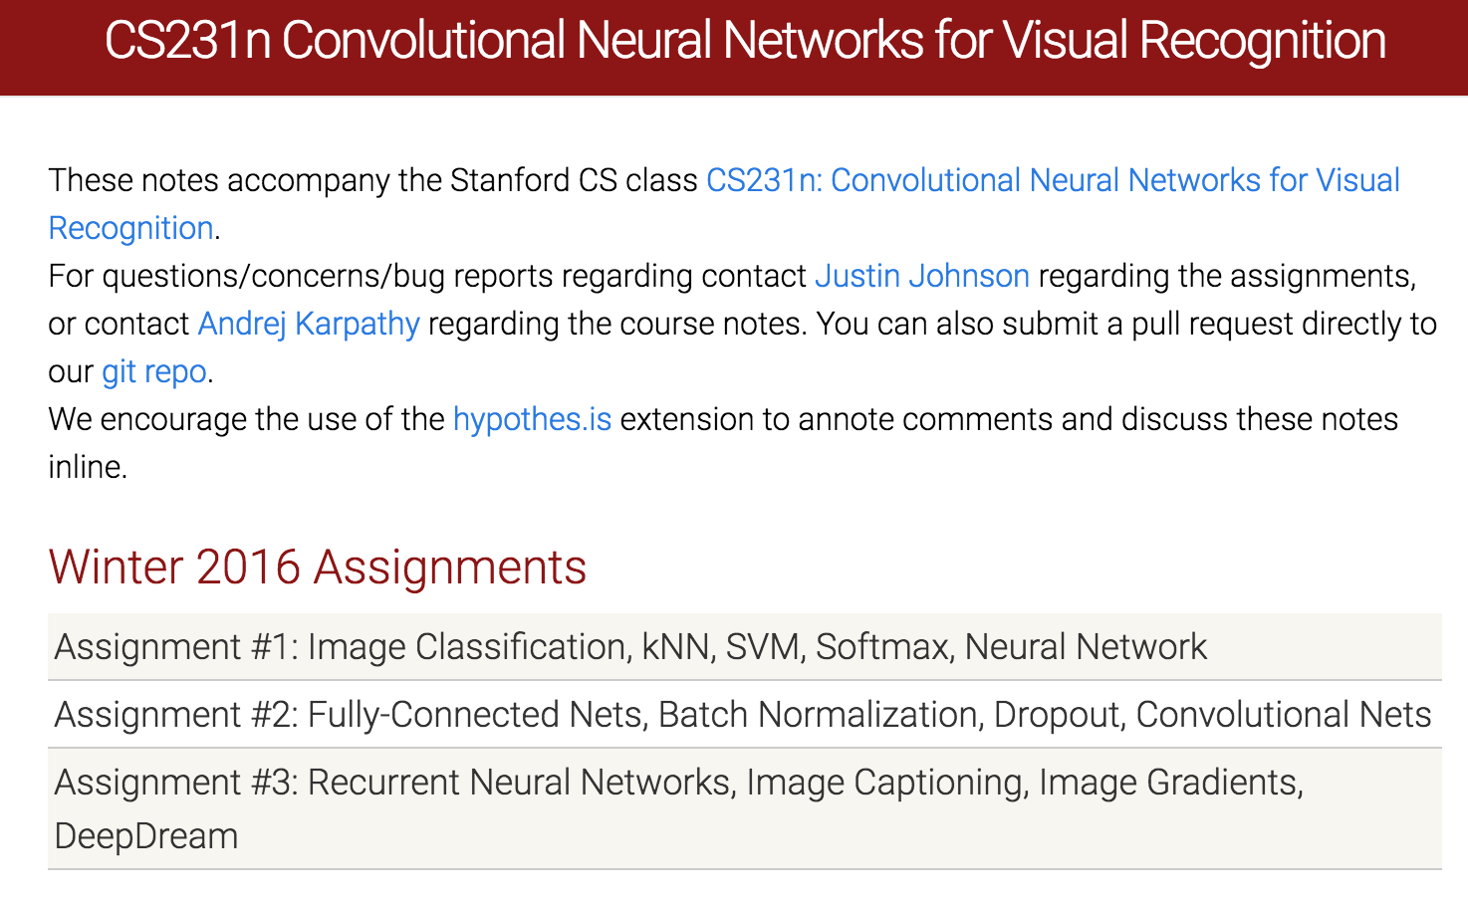
Deep learning tutorials?
http://cs231n.github.io/

Slide 8
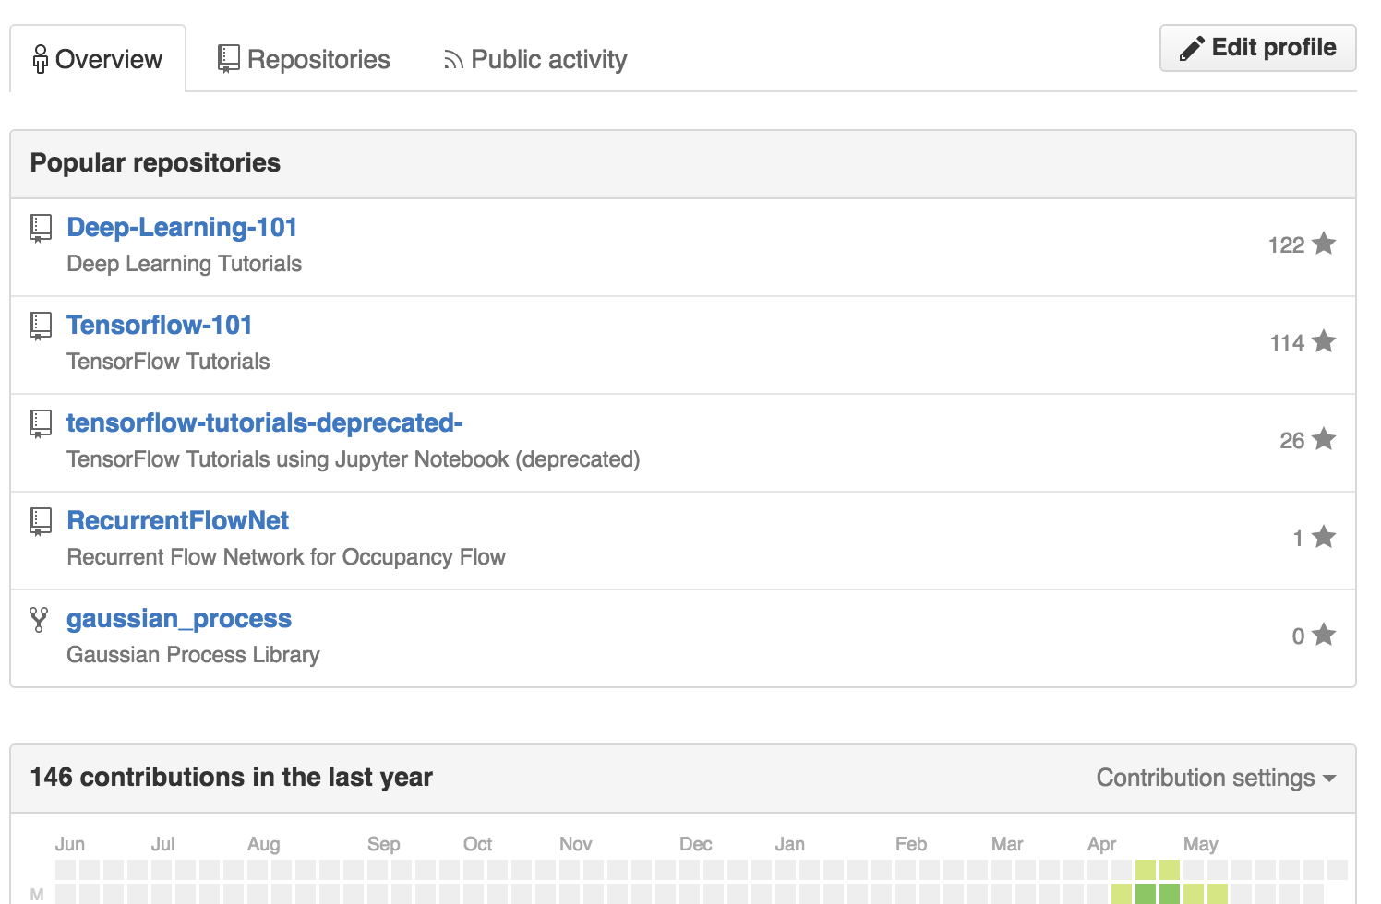
Deep learning tutorials?
https://github.com/sjchoi86

Slide 9


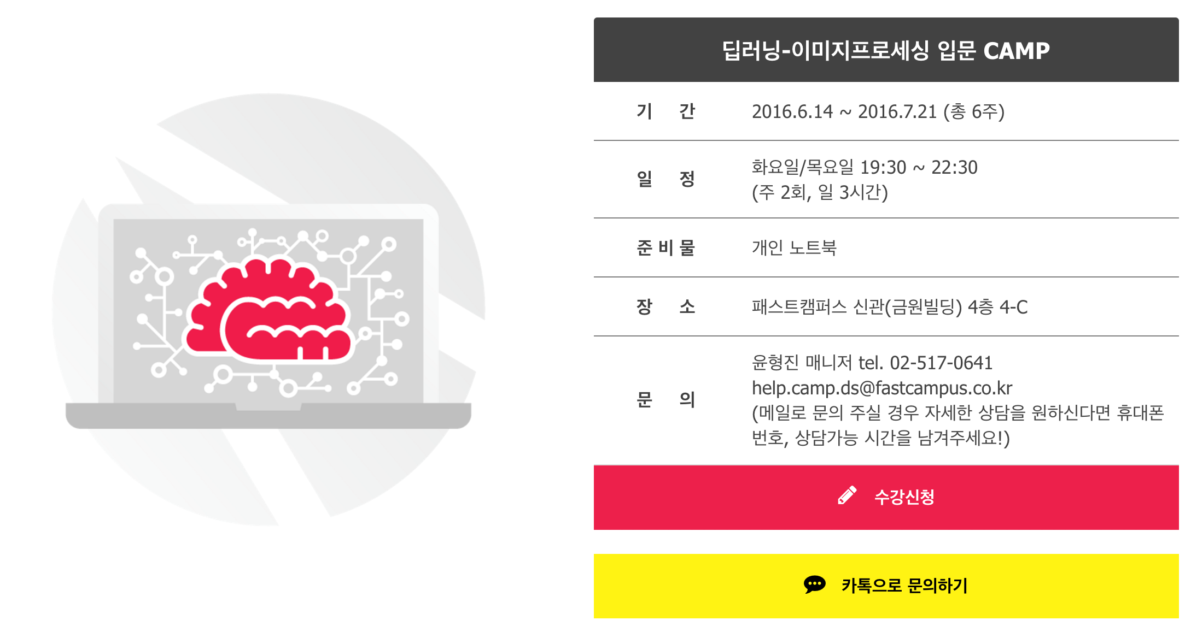
What about this one?

Slide 10
My job is to

Slide 11
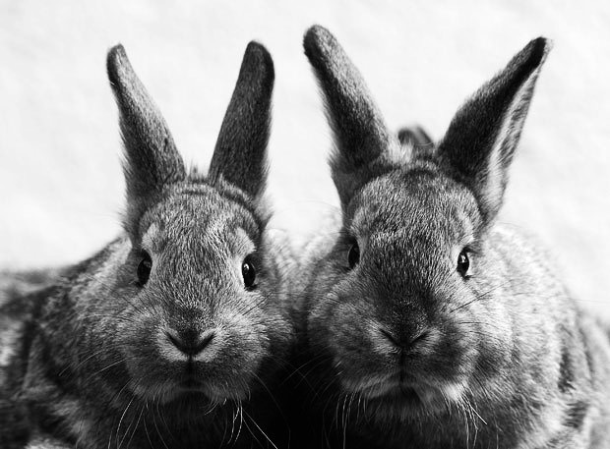
Goal
Practical Implementation Technique
Deep Learning
Theories

Slide 12

Introduce yourself

Slide 13
Grouping

Slide 14





SNS?
?

Slide 15
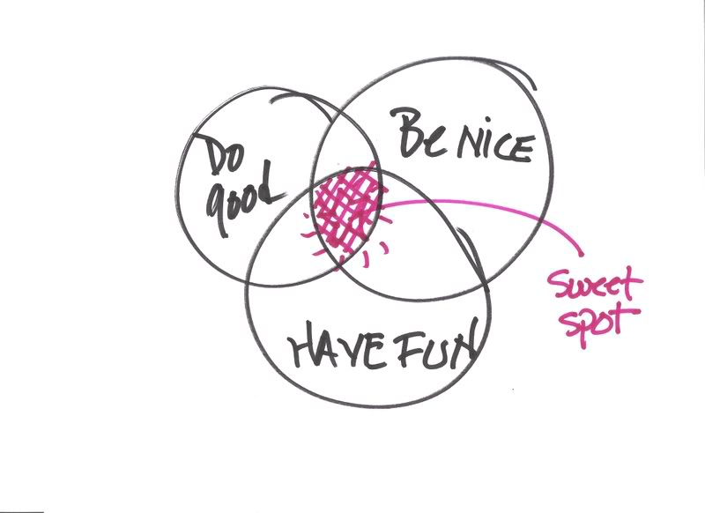


More importantly,

Slide 16


Questions

